Slide 1
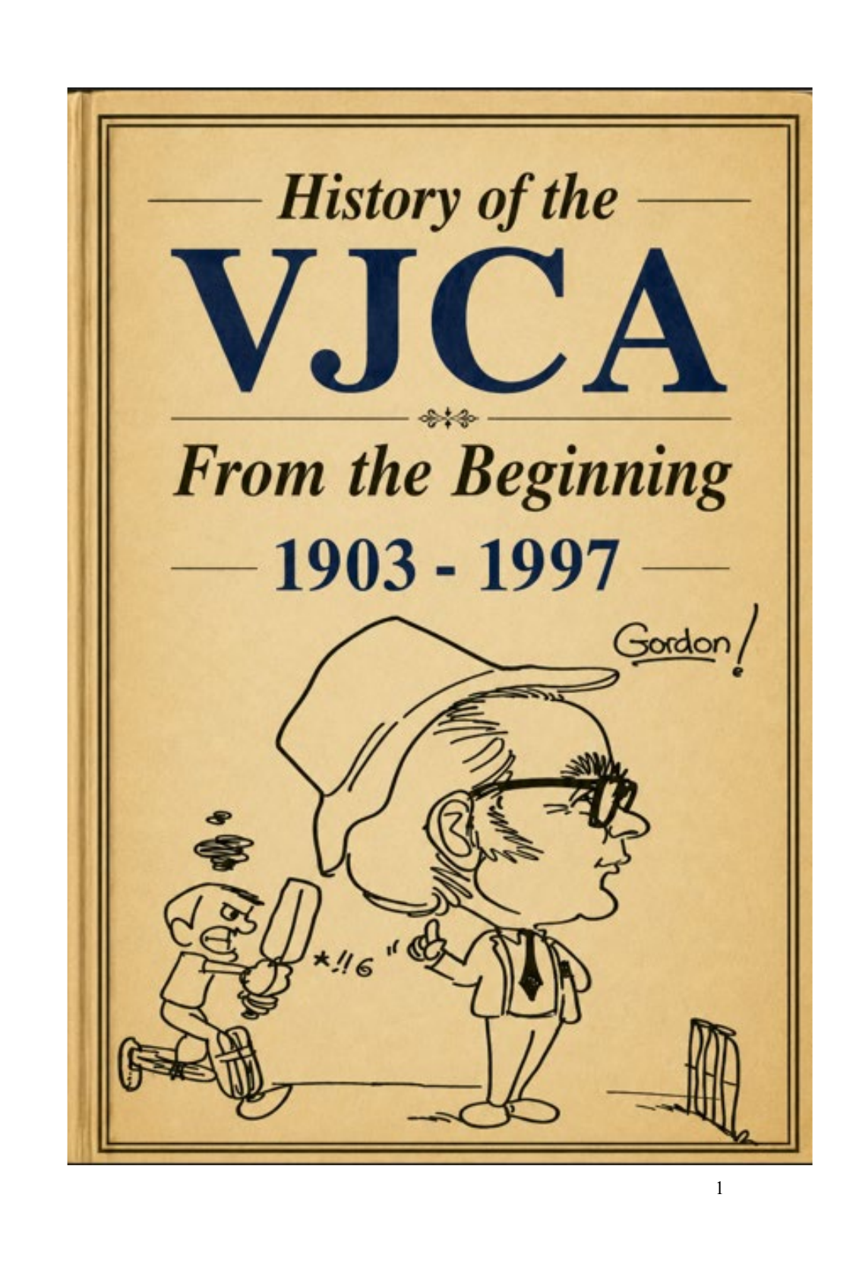
VJCA / VTCA
Club Entry Timeline
First recorded season each club/team appeared in the VJCA/VTCA source list
261 clubs/teams • 1903–1995
Prepared as a PowerPoint timeline document

Slide 2
How to read the timeline
The timeline uses the workbook’s “Start Year” and “First Recorded Season” fields.
261
identified club/team entries
1903
first recorded season
1995
last start year in this source
•
“Start Year” is treated as the first recorded VJCA/VTCA season in the supplied club list, not necessarily the original founding year of the club.
•
Historic names, footballer sides, ANA sides, business/works teams and renamed variants are preserved as separate entries where the source list records them that way.
•
The foundation season is especially important: the source narrative states 59 teams competed in 1903/04, while the compiled list identifies 56 entries.
•
Where the source is uncertain, the deck retains the wording from the workbook and presents the entry chronologically rather than interpreting it as a modern club lineage.
Source: VJCA history PDF and compiled club list workbook • “Start year” means first recorded VJCA/VTCA season in the source list.
VJCA/VTCA Club Entry Timeline
2

Slide 3
Entry waves by decade
Number of clubs/teams first recorded in each decade.
1900s
60
Foundation surge
1910s
49
1903 alone accounts for 56 entries.
1920s
5
Second wave
1930s
50
1911–12 adds 37 further entries.
1940s
6
1950s
21
1930s renewal
50 entries first appear across the decade.
1960s
11
1970s
21
Late-era additions
1980s
16
1990s list includes 22 new entries.
1990s
22
Source: VJCA history PDF and compiled club list workbook • “Start year” means first recorded VJCA/VTCA season in the source list.
VJCA/VTCA Club Entry Timeline
3

Slide 4
1903 foundation entries
Timeline page 1 of 15 • 18 entries shown
1903
1903
1903
Albert Park
1903
Canterbury
1903
Collingwood ANA
1903-04
1903-04
1903-04
1903
Ascot Vale
1903
Carlton Footballers
1903
Court Le Plastrier ADF
1903-04
1903-04
1903-04
1903
Belle Vue
1903
Chetwynd
1903
Cremorne
1903-04
1903-04
1903-04
1903
Belmont
1903
Clifton Hill
1903
Dunlop Tyre / Dunlop Rubber
1903-04
1903-04
1903-04
1903
Brunswick
1903
Clifton Hill ANA
1903
East Brunswick
1903-04
1903-04
1903-04
1903
Brunswick Footballers
1903
Coburg Juniors
1903
Emu
1903-04
1903-04
1903-04
Source: VJCA history PDF and compiled club list workbook • “Start year” means first recorded VJCA/VTCA season in the source list.
VJCA/VTCA Club Entry Timeline
4

Slide 5
1903 foundation entries
Timeline page 2 of 15 • 18 entries shown
1903
1903
1903
Essendon
1903
Kew
1903
North Park
1903-04
1903-04
1903-04
1903
Fernleigh
1903
La Mascotte (later become Collingwood)
1903
North Ports
1903-04
1903-04
1903-04
1903
Fitzroy Footballers
1903
Leopold
1903
Northcote
1903-04
1903-04
1903-04
1903
Flemington-Kensington
1903
Lincoln
1903
Northern District
1903-04
1903-04
1903-04
1903
Footscray
1903
Marleybone
1903
Parkside
1903-04
1903-04
1903-04
1903
Hotham Hill
1903
North Melbourne Westleys
1903
Parkville
1903-04
1903-04
1903-04
Source: VJCA history PDF and compiled club list workbook • “Start year” means first recorded VJCA/VTCA season in the source list.
VJCA/VTCA Club Entry Timeline
5

Slide 6
1903 foundation entries
Timeline page 3 of 15 • 18 entries shown
1903
1903
1903
Preston
1903
Rose of Northcote
1903
South Richmond
1903-04
1903-04
1903-04
1903
Primrose
1903
Rosemont
1903
South Yarra
1903-04
1903-04
1903-04
1903
Richmond Alberts
1903
Simpson's Road
1903
St Josephs CYMS
1903-04
1903-04
1903-04
1903
Richmond City
1903
South Melbourne Footballers
1903
Studley
1903-04
1903-04
1903-04
1903
Richmond Club XI
1903
South Melbourne XI
1903
Turn Verein
1903-04
1903-04
1903-04
1903
Richmond Footballers
1903
South Ports
1903
VJRCCC
1903-04
1903-04
1903-04
Source: VJCA history PDF and compiled club list workbook • “Start year” means first recorded VJCA/VTCA season in the source list.
VJCA/VTCA Club Entry Timeline
6

Slide 7
1903–1912: clubs first recorded
Timeline page 4 of 15 • 18 entries shown
1903
1912
1903
West End
1911
Court Prince of Wales
1911
St Johns
1903-04
1911-12
1911-12
1903
West Melbourne Alma
1911
Gordon / Gordons
1911
Stanley United
1903-04
1911-12
1911-12
1906
Yarraville
1911
Melbourne Electric Supply
1911
Victorian Letter Carriers
1906-07
1911-12
1911-12
1907
Carlton District
1911
Montague
1912
Adult Deaf
1907-08
1911-12
1912-13
1907
Essendon Footballers
1911
Moreland
1912
Brunswick City
1907-08
1911-12
1912-13
1907
Hawthorn
1911
North Fitzroy Congregational
1912
Brunswick St
1907-08
1911-12
1912-13
Source: VJCA history PDF and compiled club list workbook • “Start year” means first recorded VJCA/VTCA season in the source list.
VJCA/VTCA Club Entry Timeline
7

Slide 8
1912: clubs first recorded
Timeline page 5 of 15 • 18 entries shown
1912
1912
1912
Burnley Congregational / Burnley St Congregational
1912
Court Prince of Wales AOF
1912
Hand of Friendship
1912-13
1912-13
1912-13
1912
Clifton United
1912
Everleigh
1912
Kennons Tannery
1912-13
1912-13
1912-13
1912
Coburg District
1912
Fairfield Footballers
1912
Loyal Rose of Brunswick
1912-13
1912-13
1912-13
1912
College Lawn
1912
Fawkner Footballers
1912
Middle Park
1912-13
1912-13
1912-13
1912
Collingwood Footballers
1912
Glenlyon
1912
North Melbourne Districts
1912-13
1912-13
1912-13
1912
Collingwood United
1912
GPO
1912
Richmond Socials
1912-13
1912-13
1912-13
Source: VJCA history PDF and compiled club list workbook • “Start year” means first recorded VJCA/VTCA season in the source list.
VJCA/VTCA Club Entry Timeline
8

Slide 9
1912–1919: clubs first recorded
Timeline page 6 of 15 • 18 entries shown
1912
1919
1912
Rose of Fitzroy
1912
West Hawthorn
1916
Victoria Brewery
1912-13
1912-13
1916-17
1912
South Melbourne ANA
1914
Presbyterian
1919
Brunswick I.O.O.F.
1912-13
1914-15
1919-20
1912
South Melbourne Gas Works
1916
Balmain
1919
Harmony I.O.O.F. / Harmony
1912-13
1916-17
1919-20
1912
South Park
1916
Myrtle / Williamstown District
1919
Loyal Rose
1912-13
1916-17
1919-20
1912
St Ignatius
1916
Newport Workshops
1919
St George’s
1912-13
1916-17
1919-20
1912
Swallow and Ariel
1916
Railway United / Railway Unit
1919
St Ignatius'
1912-13
1916-17
1919-20
Source: VJCA history PDF and compiled club list workbook • “Start year” means first recorded VJCA/VTCA season in the source list.
VJCA/VTCA Club Entry Timeline
9

Slide 10
1919–1931: clubs first recorded
Timeline page 7 of 15 • 18 entries shown
1919
1931
1919
Teachers' College
1930
Alphington
1930
Public Service
1919-20
1930-31
1930-31
1924
Havelock
1930
Carnegie
1930
South Hawthorn
1924-25
1930-31
1930-31
1925
Tooronga
1930
Glenhuntly
1930
University High School
1925-26
1930-31
1930-31
1927
YMCA
1930
Heidelberg
1930
University High School Old Boys
1927-28
1930-31
1930-31
1929
Fairfield
1930
Lands Department
1931
Alfred Socials
1929-30
1930-31
1931-32
1929
Richmond Presbyterian
1930
Oakleigh
1931
Australian Glass
1929-30
1930-31
1931-32
Source: VJCA history PDF and compiled club list workbook • “Start year” means first recorded VJCA/VTCA season in the source list.
VJCA/VTCA Club Entry Timeline
10

Slide 11
1931: clubs first recorded
Timeline page 8 of 15 • 18 entries shown
1931
1931
1931
Australian Paper Mills
1931
Coventry
1931
Nelson
1931-32
1931-32
1931-32
1931
Bayside
1931
Essendon Club XI
1931
Nor Roy
1931-32
1931-32
1931-32
1931
Burnley Footballers
1931
Fitzroy Junior Footballers
1931
Old Xaverians
1931-32
1931-32
1931-32
1931
Clan
1931
Garden City
1931
Pinnacle
1931-32
1931-32
1931-32
1931
Clarendon
1931
Hoffman
1931
Renown
1931-32
1931-32
1931-32
1931
Court Robin Hood
1931
Liberty Socials
1931
South PAFS
1931-32
1931-32
1931-32
Source: VJCA history PDF and compiled club list workbook • “Start year” means first recorded VJCA/VTCA season in the source list.
VJCA/VTCA Club Entry Timeline
11

Slide 12
1931–1939: clubs first recorded
Timeline page 9 of 15 • 18 entries shown
1931
1939
1931
Waratah
1935
Fairfield Paper Mills
1939
Brighton
1931-32
1935-36
1939-40
1934
Burnley Amateurs
1936
Paramount
1939
Britons
1934-35
1936-37
1939-40
1934
East Prahran
1937
Box Hill
1939
Elsternwick
1934-35
1937-38
1939-40
1934
Melbourne Parks
1937
Myrall
1939
Hampton
1934-35
1937-38
1939-40
1934
St Kilda
1938
Darling
1939
Hawthorn District
1934-35
1938-39
1939-40
1934
Youlden-Kensington / Youlden-Parkville
1939
Black Rock
1939
Melbourne District
1934-35
1939-40
1939-40
Source: VJCA history PDF and compiled club list workbook • “Start year” means first recorded VJCA/VTCA season in the source list.
VJCA/VTCA Club Entry Timeline
12

Slide 13
1939–1952: clubs first recorded
Timeline page 10 of 15 • 18 entries shown
1939
1952
1939
Sandringham
1944
Woodlands
1950
North Melbourne
1939-40
1944-45
1950-51
1939
South Richmond Presbyterians
1948
Sunshine
1950
North Melbourne H.A.C.B.S.
1939-40
1948-49
1950-51
1943
Melbourne City
1950
Albion Imperials
1950
North Melbourne Socials
1943-44
1950-51
1950-51
1943
Paynesville
1950
Harbour Trust
1950
Preservene
1943-44
1950-51
1950-51
1943
Windsor
1950
Middle Park Colts
1950
Regal
1943-44
1950-51
1950-51
1944
Melbourne High School Old Boys / MHSOB
1950
North Carlton
1952
Bentleigh
1944-45
1950-51
1952-53
Source: VJCA history PDF and compiled club list workbook • “Start year” means first recorded VJCA/VTCA season in the source list.
VJCA/VTCA Club Entry Timeline
13

Slide 14
1953–1962: clubs first recorded
Timeline page 11 of 15 • 18 entries shown
1953
1962
1953
Austral
1957
Moorabbin
1961
South Caulfield
1953-54
1957-58
1961-62
1953
Olympic
1959
Euston
1961
State Bank / State Savings Bank
1953-54
1959-60
1961-62
1953
Ormond
1959
Frankston
1962
ANZ Bank
1953-54
1959-60
1962-63
1953
Royal Park
1959
Highett
1962
CYMS
1953-54
1959-60
1962-63
1954
Brunswick Anchor
1959
North Melbourne City
1962
Hakoah-Ajax
1954-55
1959-60
1962-63
1954
Murrumbeena
1961
North Richmond
1962
Melbourne Harbour Trust
1954-55
1961-62
1962-63
Source: VJCA history PDF and compiled club list workbook • “Start year” means first recorded VJCA/VTCA season in the source list.
VJCA/VTCA Club Entry Timeline
14

Slide 15
1962–1975: clubs first recorded
Timeline page 12 of 15 • 18 entries shown
1962
1975
1962
St Kevins Old Boys
1972
Altona
1973
Preston (new club/re-entry)
1962-63
1972-73
1973-74
1962
St Kevins Old Collegians
1972
La Trobe University
1973
St Bernards Old Collegians / St Bernards
1962-63
1972-73
1973-74
1965
Brunswick United
1972
Richmond Union
1975
Diamond Creek
1965-66
1972-73
1975-76
1965
Postal
1973
Altona North
1975
Heatherton
1965-66
1973-74
1975-76
1971
Werribee
1973
Newport ANA
1975
Melbourne Central
1971-72
1973-74
1975-76
1971
Westgate
1973
North Caulfield
1975
Moorabbin Park
1971-72
1973-74
1975-76
Source: VJCA history PDF and compiled club list workbook • “Start year” means first recorded VJCA/VTCA season in the source list.
VJCA/VTCA Club Entry Timeline
15

Slide 16
1975–1986: clubs first recorded
Timeline page 13 of 15 • 18 entries shown
1975
1986
1975
Old Essendon Grammarians
1979
Melton
1984
Newport East
1975-76
1979-80
1984-85
1975
St Kilda Christian Brothers College / St Kilda CBC
1984
Beaumaris
1984
Noble Park
1975-76
1984-85
1984-85
1975
Watsonia
1984
Chelsea
1984
Old Paradians
1975-76
1984-85
1984-85
1977
Parkdale
1984
Cheltenham
1984
Sandringham-Black Rock
1977-78
1984-85
1984-85
1978
Old Mentonians
1984
Clayton
1984
Springvale
1978-79
1984-85
1984-85
1978
State Bank
1984
Clayton District
1986
Ajax
1978-79
1984-85
1986-87
Source: VJCA history PDF and compiled club list workbook • “Start year” means first recorded VJCA/VTCA season in the source list.
VJCA/VTCA Club Entry Timeline
16

Slide 17
1986–1993: clubs first recorded
Timeline page 14 of 15 • 18 entries shown
1986
1993
1986
Avondale Heights
1992
Glenroy Amateurs / Glenroy
1993
Aspendale
1986-87
1992-93
1993-94
1986
North Old Boys
1992
Keilor
1993
Commonwealth Bank
1986-87
1992-93
1993-94
1987
Dingley
1992
Mordialloc
1993
Doutta / Doutta Stars
1987-88
1992-93
1993-94
1989
Hoppers Crossing
1993
Aberfeldie
1993
Jacana
1989-90
1993-94
1993-94
1989
South Essendon
1993
Aberfeldie Park
1993
Kensington
1989-90
1993-94
1993-94
1992
East Keilor
1993
Airport West St Christophers
1993
Parkville District
1992-93
1993-94
1993-94
Source: VJCA history PDF and compiled club list workbook • “Start year” means first recorded VJCA/VTCA season in the source list.
VJCA/VTCA Club Entry Timeline
17

Slide 18
1993–1995: clubs first recorded
Timeline page 15 of 15 • 9 entries shown
1993
1995
1993
West Meadows
1995
St Brigids/St Louis
1993-94
1995-96
1995
Beaumaris United
1995
St Johns/St Bedes
1995-96
1995-96
1995
Bon Beach/Edithvale
1995
Yarraville Club
1995-96
1995-96
1995
Doutta Stars
1995-96
1995
North Caulfield/Glenhuntly
1995-96
1995
Parkdale United
1995-96
Source: VJCA history PDF and compiled club list workbook • “Start year” means first recorded VJCA/VTCA season in the source list.
VJCA/VTCA Club Entry Timeline
18

Slide 19
Complete chronological index
The preceding timeline pages contain all 261 entries from the compiled workbook.
Suggested use
Use this deck as a working historical index. The first recorded season can be cross-checked against the VJCA history PDF and any later VTCA records before publication.
Key caution
The timeline records when a club/team first appears in the VJCA/VTCA source list. It should not be read as a definitive club formation date unless supported by club records.
Source: VJCA history PDF and compiled club list workbook • “Start year” means first recorded VJCA/VTCA season in the source list.
VJCA/VTCA Club Entry Timeline
19

